Slide 1

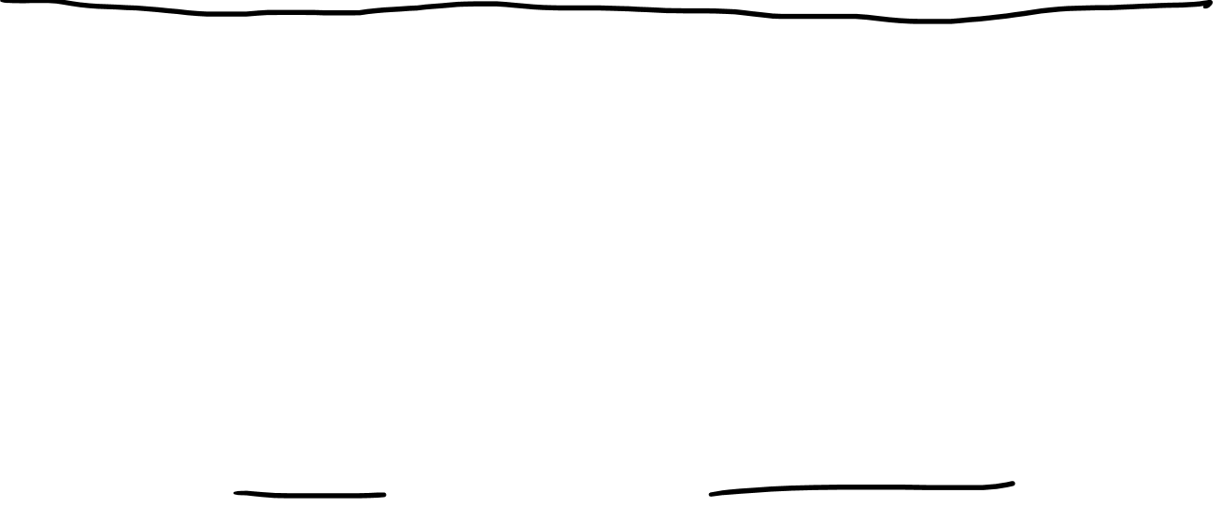

Tensor Product Spaces
Warning: Video contains
non-standard tensor product notation
$$\vec{e_{i}}ε^{j}$$
$$\vec{e_{i}}⊗ε^{j}$$

Slide 2
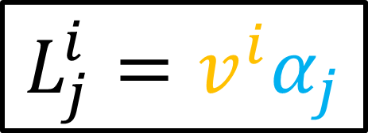
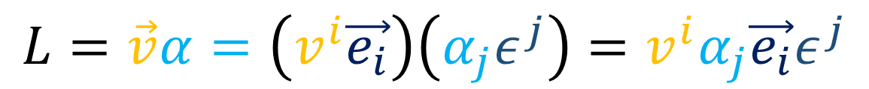
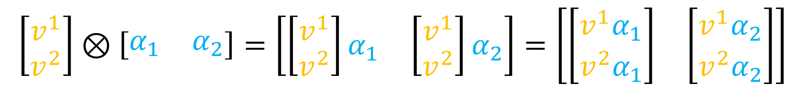
$$L=\vec{v}α=\left(v^{i}\vec{e_{i}}\right)\left(α_{j}ε^{j}\right)=v^{i}α_{j}\vec{e_{i}}ε^{j}$$
$$L_{j}^{i}=v^{i}α_{j}$$
$$\left[\begin{matrix}v^{1} \\ v^{2}\end{matrix}\right]⊗\left[\begin{matrix}α_{1} & α_{2}\end{matrix}\right]=\left[\begin{matrix}\left[\begin{matrix}v^{1} \\ v^{2}\end{matrix}\right]α_{1} & \left[\begin{matrix}v^{1} \\ v^{2}\end{matrix}\right]α_{2}\end{matrix}\right]=\left[\begin{matrix}\left[\begin{matrix}v^{1}α_{1} \\ v^{2}α_{1}\end{matrix}\right] & \left[\begin{matrix}v^{1}α_{2} \\ v^{2}α_{2}\end{matrix}\right]\end{matrix}\right]$$

Slide 3
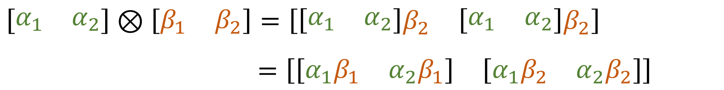
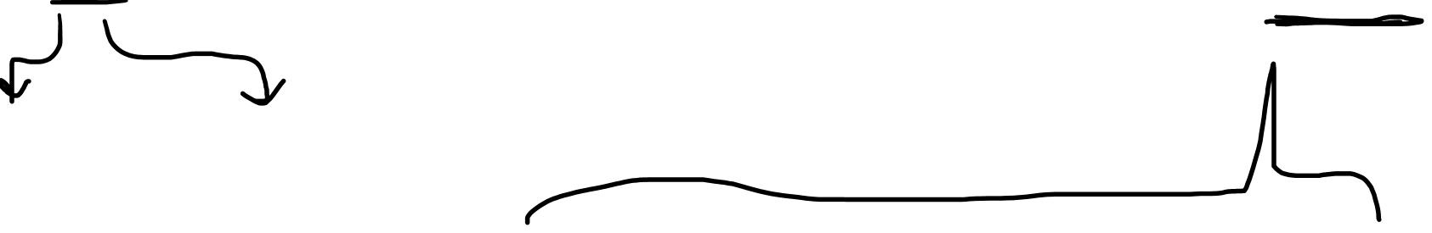

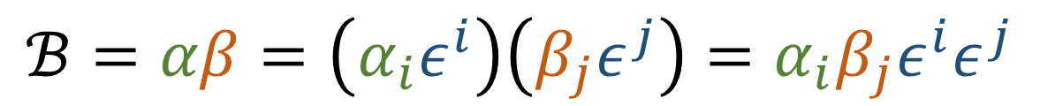
$$ℬ=αβ=\left(α_{i}ε^{i}\right)\left(β_{j}ε^{j}\right)=α_{i}β_{j}ε^{i}ε^{j}$$
$$ℬ_{ij}=α_{i}β_{j}$$
$$\left[\begin{matrix}α_{1} & α_{2}\end{matrix}\right]⊗\left[\begin{matrix}β_{1} & β_{2}\end{matrix}\right]=\left[\begin{matrix}\left[\begin{matrix}α_{1} & α_{2}\end{matrix}\right]β_{2} & \left[\begin{matrix}α_{1} & α_{2}\end{matrix}\right]β_{2}\end{matrix}\right]$$
$=\left[\begin{matrix}\left[\begin{matrix}α_{1}β_{1} & α_{2}β_{1}\end{matrix}\right] & \left[\begin{matrix}α_{1}β_{2} & α_{2}β_{2}\end{matrix}\right]\end{matrix}\right]$

Slide 4


Formally Define the
Tensor Product
$$TS$$
$$T⊗S$$

Slide 5
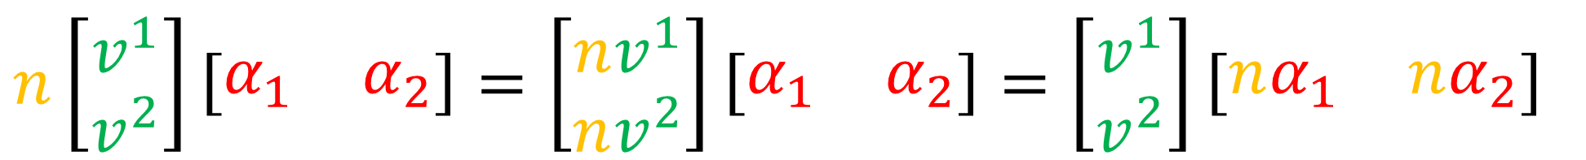
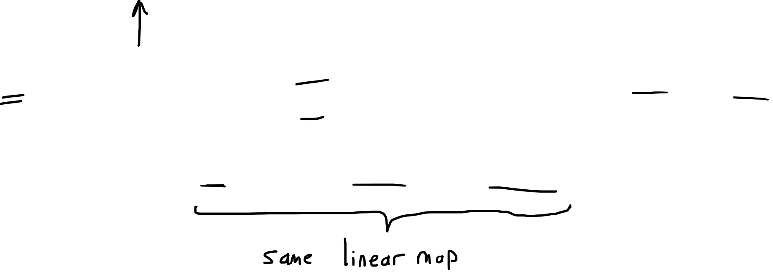
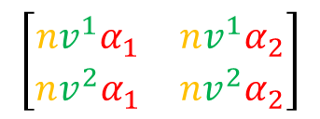
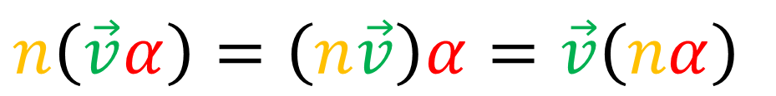
$$\left[\begin{matrix}\begin{aligned}nv^{1}α_{1} \\ nv^{2}α_{1}\end{aligned} & \begin{aligned}nv^{1}α_{2} \\ nv^{2}α_{2}\end{aligned}\end{matrix}\right]$$
$$n\left[\begin{aligned}v^{1} \\ v^{2}\end{aligned}\right]\left[\begin{matrix}α_{1} & α_{2}\end{matrix}\right]=\left[\begin{aligned}nv^{1} \\ nv^{2}\end{aligned}\right]\left[\begin{matrix}α_{1} & α_{2}\end{matrix}\right]=\left[\begin{aligned}v^{1} \\ v^{2}\end{aligned}\right]\left[\begin{matrix}nα_{1} & nα_{2}\end{matrix}\right]$$
$$n\left(\vec{v}α\right)=\left(n\vec{v}\right)α=\vec{v}\left(nα\right)$$

Slide 6
$$n\left(\left[\begin{aligned}v^{1} \\ v^{2}\end{aligned}\right]⊗\left[\begin{matrix}α_{1} & α_{2}\end{matrix}\right]\right)=\left[\begin{aligned}nv^{1} \\ nv^{2}\end{aligned}\right]⊗\left[\begin{matrix}α_{1} & α_{2}\end{matrix}\right]=\left[\begin{aligned}v^{1} \\ v^{2}\end{aligned}\right]⊗\left[\begin{matrix}nα_{1} & nα_{2}\end{matrix}\right]$$
$$n\left(\vec{v}α\right)=\left(n\vec{v}\right)α=\vec{v}\left(nα\right)$$

Slide 7
$$n\left(\left[\begin{aligned}v^{1} \\ v^{2}\end{aligned}\right]⊗\left[\begin{matrix}α_{1} & α_{2}\end{matrix}\right]\right)=\left[\begin{aligned}nv^{1} \\ nv^{2}\end{aligned}\right]⊗\left[\begin{matrix}α_{1} & α_{2}\end{matrix}\right]=\left[\begin{aligned}v^{1} \\ v^{2}\end{aligned}\right]⊗\left[\begin{matrix}nα_{1} & nα_{2}\end{matrix}\right]$$
$$n\left(\vec{v}⊗α\right)=\left(n\vec{v}\right)⊗α=\vec{v}⊗\left(nα\right)$$

Slide 8
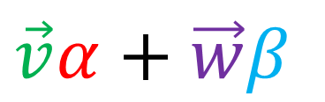
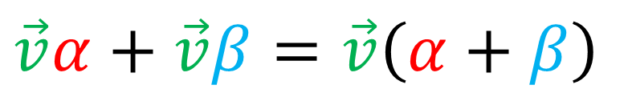
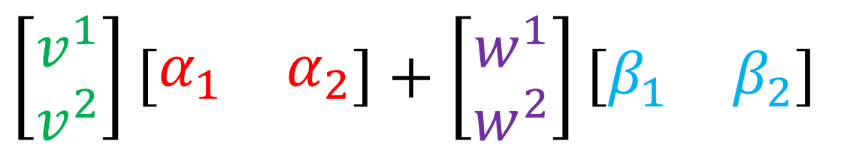
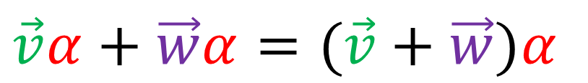
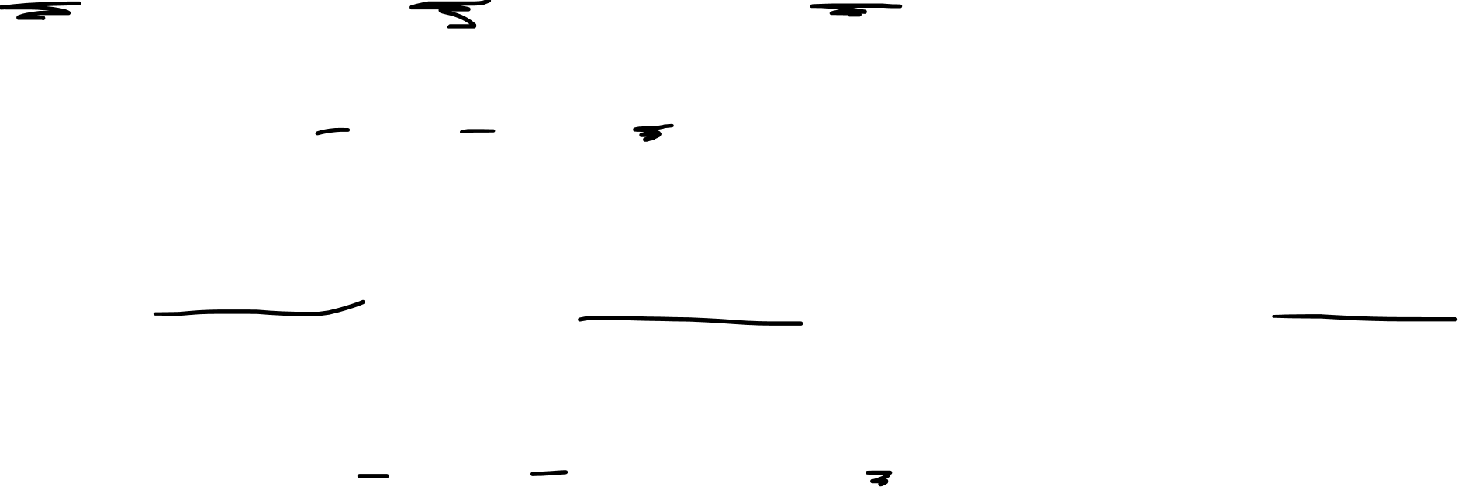
$$\left[\begin{aligned}v^{1} \\ v^{2}\end{aligned}\right]\left[\begin{matrix}α_{1} & α_{2}\end{matrix}\right]+\left[\begin{aligned}v^{1} \\ v^{2}\end{aligned}\right]\left[\begin{matrix}β_{1} & β_{2}\end{matrix}\right]=\left[\begin{aligned}v^{1} \\ v^{2}\end{aligned}\right]\left(\left[\begin{matrix}α_{1} & α_{2}\end{matrix}\right]+\left[\begin{matrix}β_{1} & β_{2}\end{matrix}\right]\right)$$
$$\vec{v}α+\vec{v}β=\vec{v}\left(α+β\right)$$
$$\left[\begin{aligned}v^{1} \\ v^{2}\end{aligned}\right]\left[\begin{matrix}α_{1} & α_{2}\end{matrix}\right]+\left[\begin{aligned}w^{1} \\ w^{2}\end{aligned}\right]\left[\begin{matrix}α_{1} & α_{2}\end{matrix}\right]=\left(\left[\begin{aligned}v^{1} \\ v^{2}\end{aligned}\right]+\left[\begin{aligned}w^{1} \\ w^{2}\end{aligned}\right]\right)\left[\begin{matrix}α_{1} & α_{2}\end{matrix}\right]$$
$$\vec{v}α+\vec{w}α=(\vec{v}+\vec{w})α$$
$$\left[\begin{aligned}v^{1} \\ v^{2}\end{aligned}\right]\left[\begin{matrix}α_{1} & α_{2}\end{matrix}\right]+\left[\begin{aligned}w^{1} \\ w^{2}\end{aligned}\right]\left[\begin{matrix}β_{1} & β_{2}\end{matrix}\right]$$
$$\vec{v}α+\vec{w}β$$

Slide 9
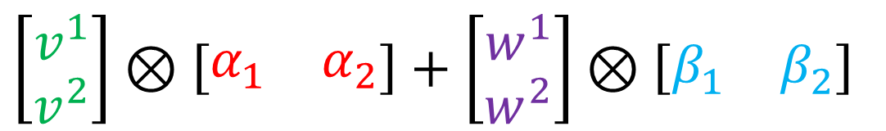
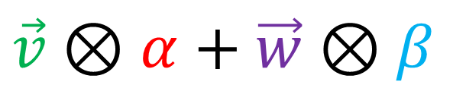
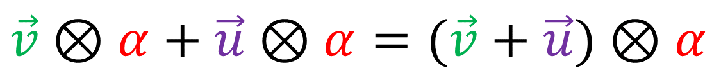
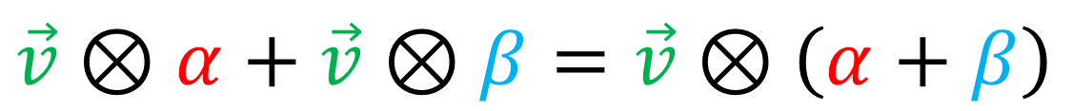
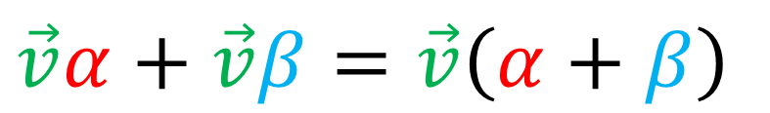

$$\left[\begin{aligned}v^{1} \\ v^{2}\end{aligned}\right]⊗\left[\begin{matrix}α_{1} & α_{2}\end{matrix}\right]+\left[\begin{aligned}v^{1} \\ v^{2}\end{aligned}\right]⊗\left[\begin{matrix}β_{1} & β_{2}\end{matrix}\right]=\left[\begin{aligned}v^{1} \\ v^{2}\end{aligned}\right]⊗\left(\left[\begin{matrix}α_{1} & α_{2}\end{matrix}\right]+\left[\begin{matrix}β_{1} & β_{2}\end{matrix}\right]\right)$$
$$\vec{v}α+\vec{v}β=\vec{v}\left(α+β\right)$$
$$\vec{v}⊗α+\vec{v}⊗β=\vec{v}⊗\left(α+β\right)$$
$$\left[\begin{aligned}v^{1} \\ v^{2}\end{aligned}\right]⊗\left[\begin{matrix}α_{1} & α_{2}\end{matrix}\right]+\left[\begin{aligned}w^{1} \\ w^{2}\end{aligned}\right]⊗\left[\begin{matrix}α_{1} & α_{2}\end{matrix}\right]=\left(\left[\begin{aligned}v^{1} \\ v^{2}\end{aligned}\right]+\left[\begin{aligned}w^{1} \\ w^{2}\end{aligned}\right]\right)⊗\left[\begin{matrix}α_{1} & α_{2}\end{matrix}\right]$$
$$\vec{v}⊗α+\vec{u}⊗α=(\vec{v}+\vec{u})⊗α$$
$$\vec{v}α+\vec{w}α=(\vec{v}+\vec{w})α$$
$$\left[\begin{aligned}v^{1} \\ v^{2}\end{aligned}\right]⊗\left[\begin{matrix}α_{1} & α_{2}\end{matrix}\right]+\left[\begin{aligned}w^{1} \\ w^{2}\end{aligned}\right]⊗\left[\begin{matrix}β_{1} & β_{2}\end{matrix}\right]$$
$$\vec{v}⊗α+\vec{w}⊗β$$
$$\vec{v}α+\vec{w}β$$

Slide 10
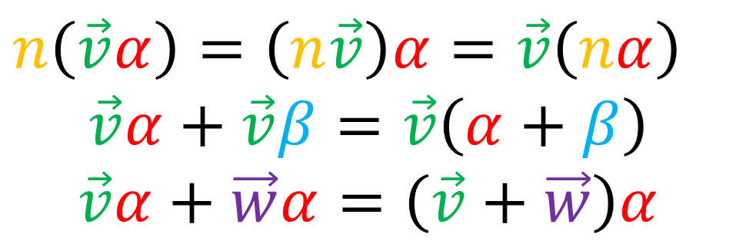
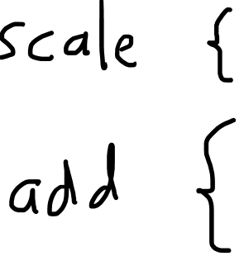
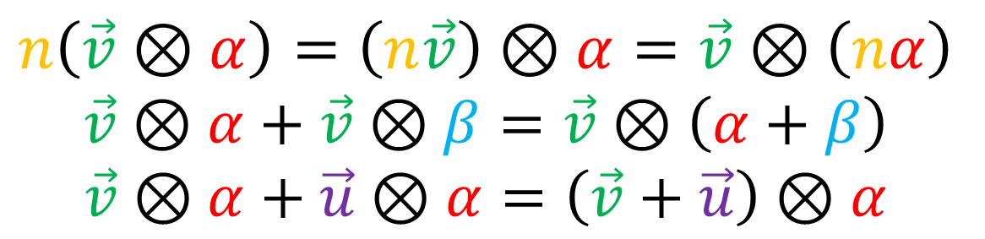
Tensor product definition
$$n\left(\vec{v}α\right)=\left(n\vec{v}\right)α=\vec{v}\left(nα\right)$$
$$\vec{v}α+\vec{v}β=\vec{v}\left(α+β\right)$$
$$\vec{v}α+\vec{w}α=\left(\vec{v}+\vec{w}\right)α$$
$$n\left(\vec{v}⊗α\right)=\left(n\vec{v}\right)⊗α=\vec{v}⊗\left(nα\right)$$
$$\vec{v}⊗α+\vec{v}⊗β=\vec{v}⊗\left(α+β\right)$$
$$\vec{v}⊗α+\vec{u}⊗α=\left(\vec{v}+\vec{u}\right)⊗α$$

Slide 11
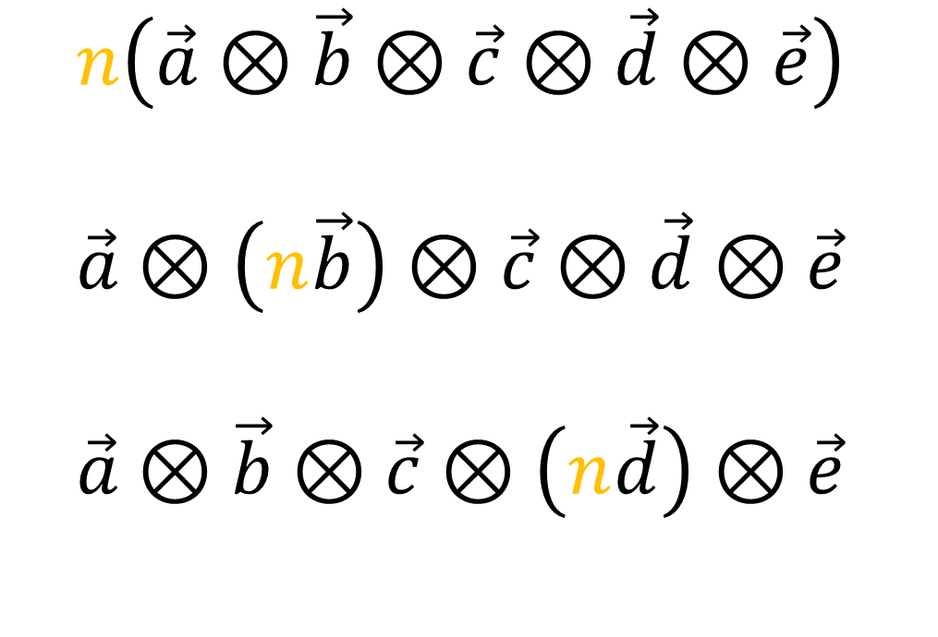
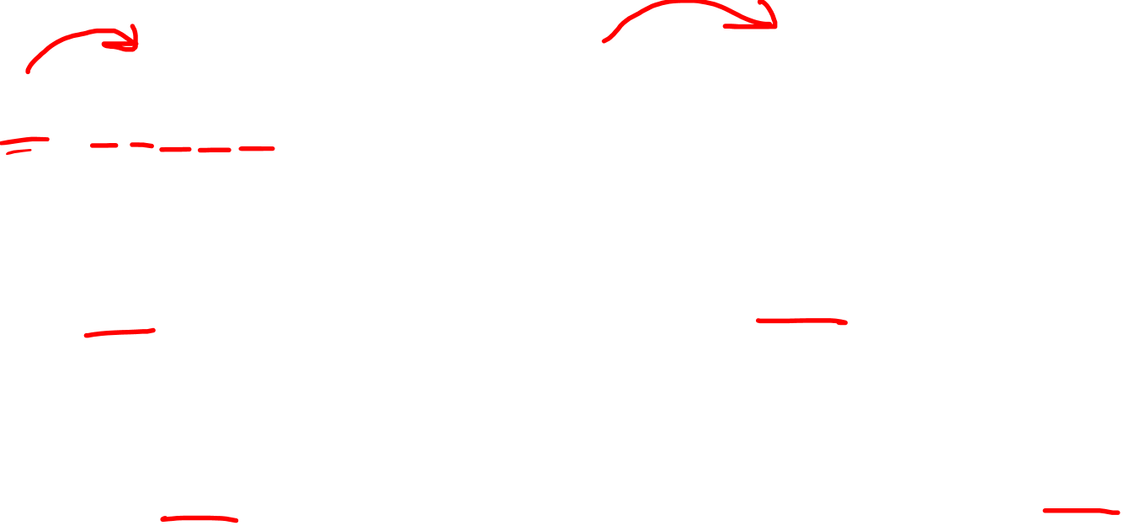

Tensor product scaling rules
$$n\left(\vec{a}\vec{b}\vec{c}\vec{d}\vec{e}\right)$$
$$\vec{a}\left(n\vec{b}\right)\vec{c}\vec{d}\vec{e}$$
$$\vec{a}\vec{b}\vec{c}\left(n\vec{d}\right)\vec{e}$$
$$n\left(\vec{a}⊗\vec{b}⊗\vec{c}⊗\vec{d}⊗\vec{e}\right)$$
$$\vec{a}⊗\left(n\vec{b}\right)⊗\vec{c}⊗\vec{d}⊗\vec{e}$$
$$\vec{a}⊗\vec{b}⊗\vec{c}⊗\left(n\vec{d}\right)⊗\vec{e}$$

Slide 12

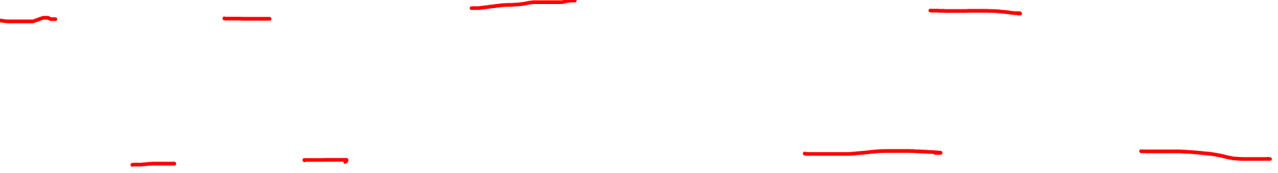
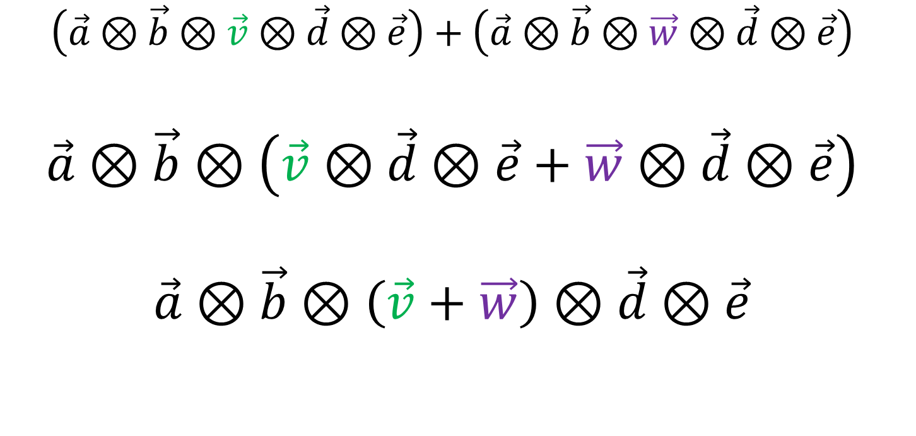
Tensor product adding rules
$$\vec{a}\vec{b}\vec{v}\vec{d}\vec{e}+\vec{a}\vec{b}\vec{w}\vec{d}\vec{e}$$
$$\vec{a}\vec{b}\left(\vec{v}\vec{d}\vec{e}+\vec{w}\vec{d}\vec{e}\right)$$
$$\vec{a}\vec{b}\left(\vec{v}+\vec{w}\right)\vec{d}\vec{e}$$
$$\left(\vec{a}⊗\vec{b}⊗\vec{v}⊗\vec{d}⊗\vec{e}\right)+\left(\vec{a}⊗\vec{b}⊗\vec{w}⊗\vec{d}⊗\vec{e}\right)$$
$$\vec{a}⊗\vec{b}⊗\left(\vec{v}⊗\vec{d}⊗\vec{e}+\vec{w}⊗\vec{d}⊗\vec{e}\right)$$
$$\vec{a}⊗\vec{b}⊗\left(\vec{v}+\vec{w}\right)⊗\vec{d}⊗\vec{e}$$

Slide 13

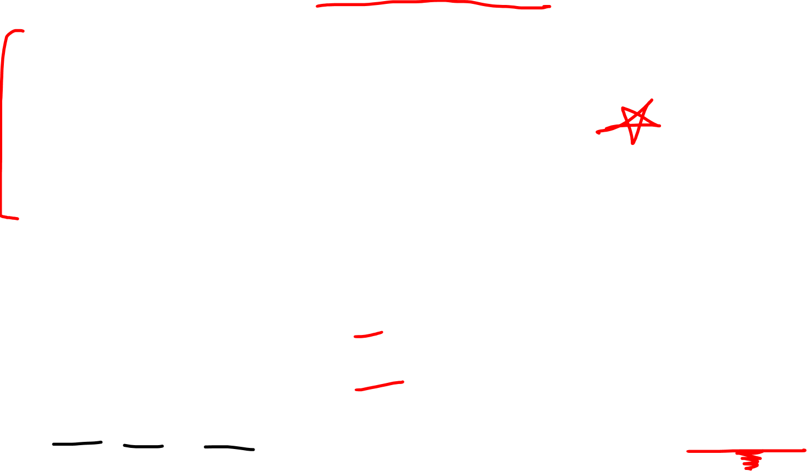
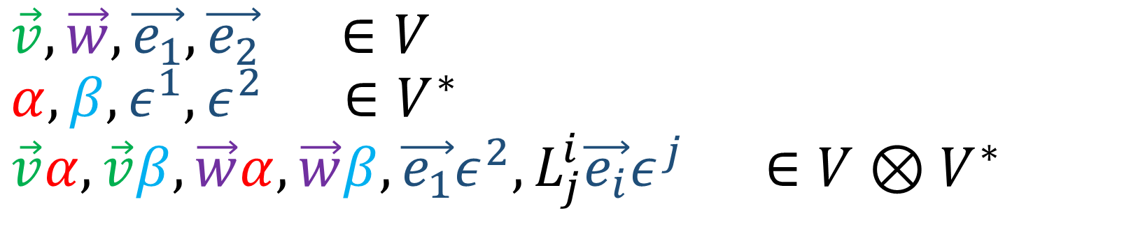
Tensor product Vector Space rules
$$n\left(\vec{v}α\right)=\left(n\vec{v}\right)α=\vec{v}\left(nα\right)$$
$$\vec{v}α+\vec{v}β=\vec{v}\left(α+β\right)$$
$$\vec{v}α+\vec{w}α=\left(\vec{v}+\vec{w}\right)α$$
$$\vec{v}, \vec{w}, \vec{e_{1}},\vec{e_{2}} ∈V$$
$$α,β,ε^{1},ε^{2} ∈V^{∗}$$
$$\vec{v}α,\vec{v}β,\vec{w}α,\vec{w}β,\vec{e_{1}}ε^{2},L_{j}^{i}\vec{e_{i}}ε^{j} ∈V⊗V^{∗}$$

Slide 14
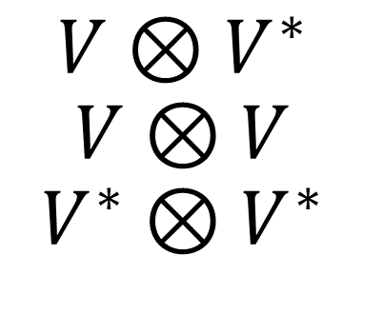
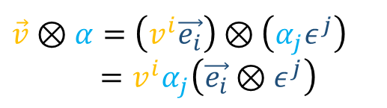
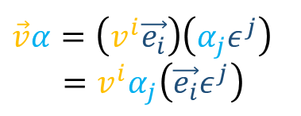
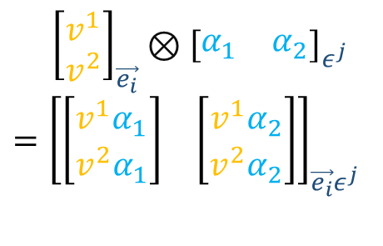
The $⊗$ symbol…
Tensor Product of Vector Spaces
(Combines Vector Spaces)
Kronecker Product
(Combines Arrays)
Tensor Product of Tensors
(Combines Tensors)
$$\vec{v}α=\left(v^{i}\vec{e_{i}}\right)\left(α_{j}ε^{j}\right)$$
$$=v^{i}α_{j}\left(\vec{e_{i}}ε^{j}\right)$$
${\left[\begin{aligned}v^{1} \\ v^{2}\end{aligned}\right]}_{\vec{e_{i}}}⊗{\left[\begin{matrix}α_{1} & α_{2}\end{matrix}\right]}_{ε^{j}}$
$$={\left[\begin{matrix}\left[\begin{aligned}v^{1}α_{1} \\ v^{2}α_{1}\end{aligned}\right] & \left[\begin{aligned}v^{1}α_{2} \\ v^{2}α_{2}\end{aligned}\right]\end{matrix}\right]}_{\vec{e_{i}}ε^{j}}$$
$$V⊗V^{∗}$$
$$V⊗V$$
$$V^{∗}⊗V^{∗}$$
$$\vec{v}⊗α=\left(v^{i}\vec{e_{i}}\right)⊗\left(α_{j}ε^{j}\right)$$
$$=v^{i}α_{j}\left(\vec{e_{i}}⊗ε^{j}\right)$$

Slide 15

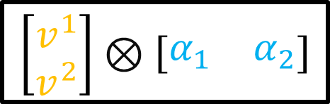
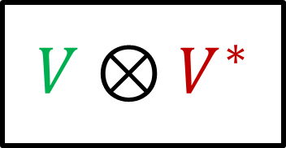
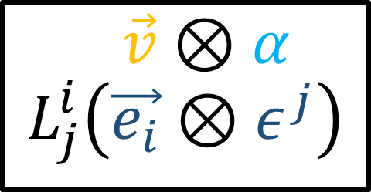
The $⊗$ symbol…
Tensor Product of Vector Spaces
(Combines Vector Spaces)
Kronecker Product
(Combines Arrays)
Tensor Product of Tensors
(Combines Tensors)
$$\vec{v}⊗α$$
$$L_{j}^{i}\left(\vec{e_{i}}⊗ε^{j}\right)$$
$$\left[\begin{aligned}v^{1} \\ v^{2}\end{aligned}\right]⊗\left[\begin{matrix}α_{1} & α_{2}\end{matrix}\right]$$
$$V⊗V^{∗}$$

Slide 16
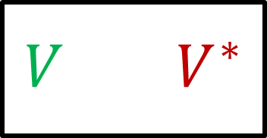



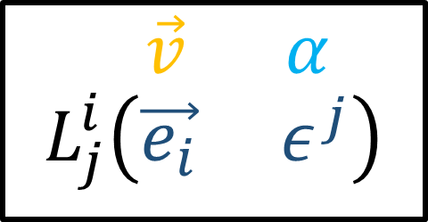

The $⊗$ symbol…
Tensor Product of Vector Spaces
(Combines Vector Spaces)
Kronecker Product
(Combines Arrays)
Tensor Product of Tensors
(Combines Tensors)
$$\vec{v} α$$
$$L_{j}^{i}\left(\vec{e_{i}} ε^{j}\right)$$
$$⊗$$
$$⊗$$
$$\left[\begin{aligned}v^{1} \\ v^{2}\end{aligned}\right]⊗\left[\begin{matrix}α_{1} & α_{2}\end{matrix}\right]$$
$$V V^{∗}$$
$$⊗$$

Slide 17

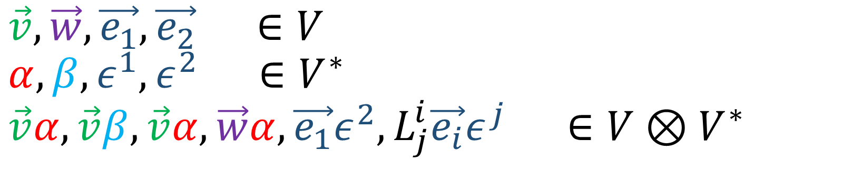
Tensor product Vector Space rules
$$n\left(\vec{v}α\right)=\left(n\vec{v}\right)α=\vec{v}\left(nα\right)$$
$$\vec{v}α+\vec{v}β=\vec{v}\left(α+β\right)$$
$$\vec{v}α+\vec{w}α=\left(\vec{v}+\vec{w}\right)α$$
$$\vec{v}, \vec{w}, \vec{e_{1}},\vec{e_{2}} ∈V$$
$$α,β,ε^{1},ε^{2} ∈V^{∗}$$
$$\vec{v}α,\vec{v}β,\vec{v}α,\vec{w}α,\vec{e_{1}}ε^{2},L_{j}^{i}\vec{e_{i}}ε^{j} ∈V⊗V^{∗}$$

Slide 18
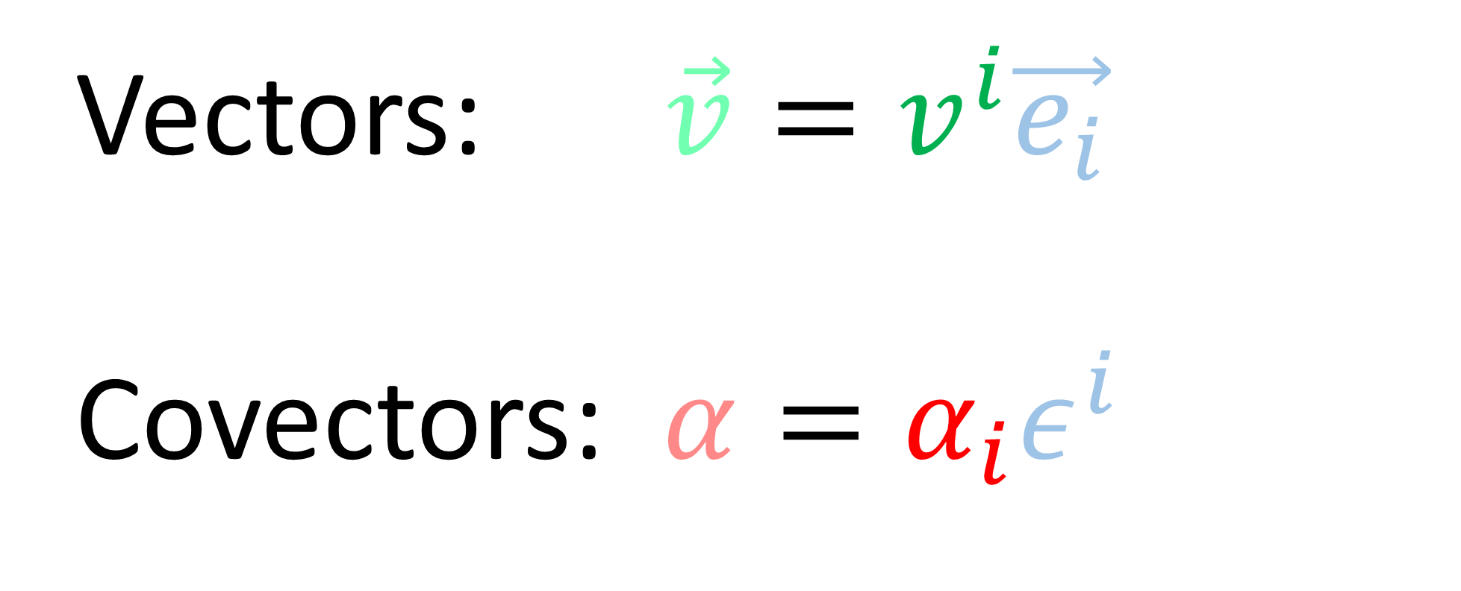

Vectors: $\vec{v}=v^{i}\vec{e_{i}}$
Covectors: $α=α_{i}ε^{i}$

Slide 19

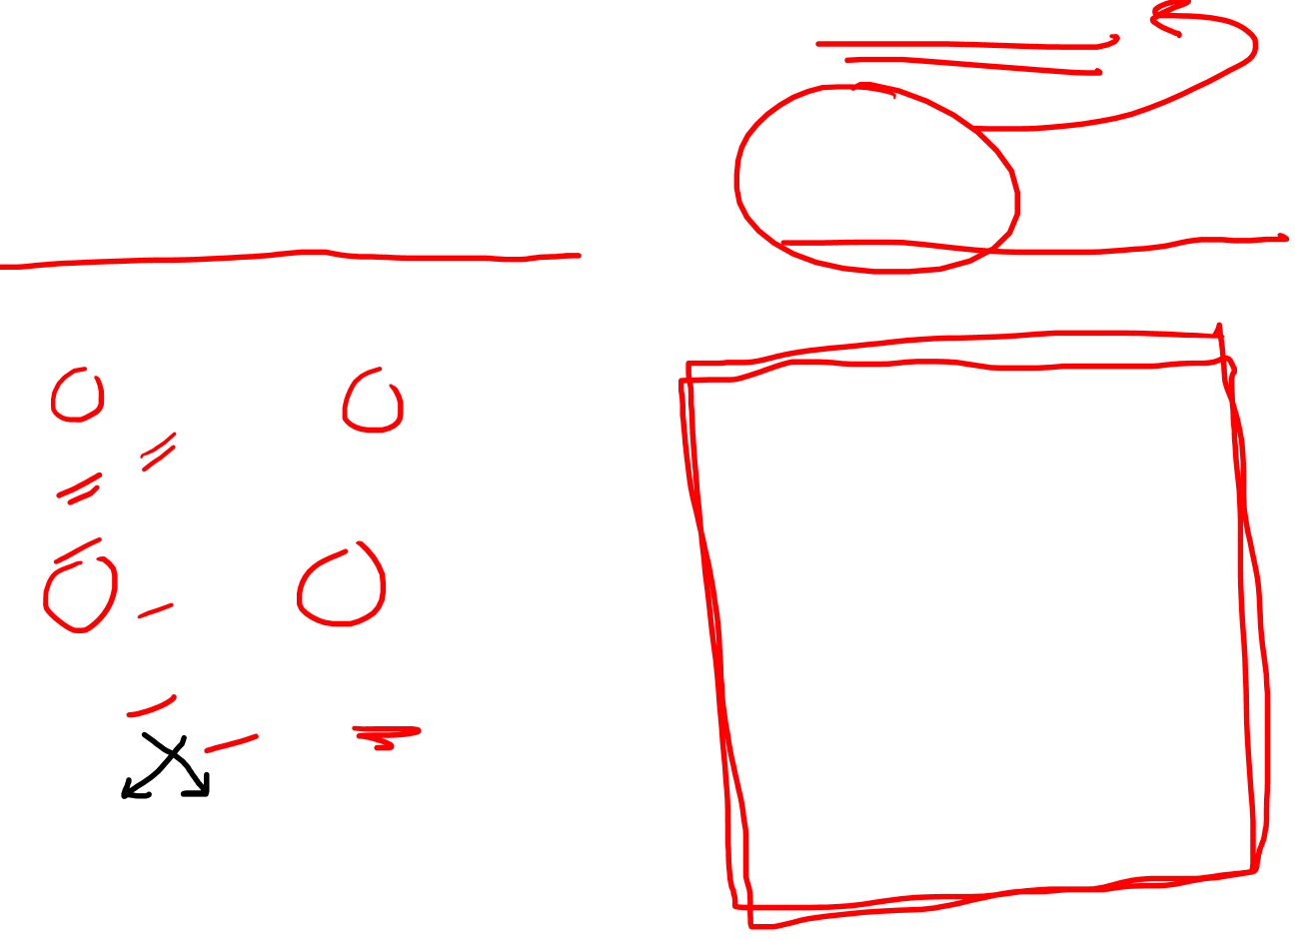

What are the elements of $V⊗V^{∗}$?
(1,1)-Tensors
$$L_{j}^{i}\vec{e_{i}}ε^{j}∈V⊗V^{∗}$$
$L_{j}^{i}v^{j}=w^{i}$ $V →V$
$L_{j}^{i}α_{i}=β_{j}$ $V^{∗} →V^{∗}$
$L_{j}^{i}v^{j}α_{i}=s$ $V×V^{∗}→ℝ$
$L_{j}^{i}α_{i}v^{j}=s$ $V^{∗}×V→ℝ$

Slide 20

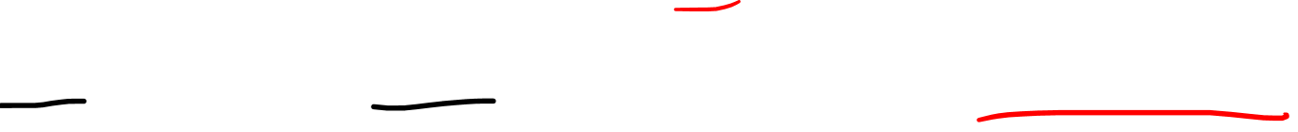
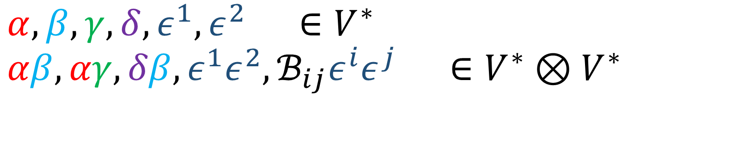
Tensor product Vector Space rules
$$n\left(αβ\right)=\left(nα\right)β=α\left(nβ\right)$$
$$αβ+αγ=α\left(β+γ\right)$$
$$αβ+δβ=\left(α+δ\right)β$$
$$α,β,γ,δ,ε^{1},ε^{2} ∈V^{∗}$$
$$αβ,αγ,δβ,ε^{1}ε^{2},ℬ_{ij}ε^{i}ε^{j} ∈V^{∗}⊗V^{∗}$$

Slide 21



What are the elements of $V^{∗}⊗V^{∗}$?
(0,2)-Tensors
$$ℬ_{ij}ε^{i}ε^{j}∈V^{∗}⊗V^{∗}$$
$ℬ_{ij}v^{i}w^{j}=s$ $V×V→ℝ$
$ℬ_{ij}v^{i}=α_{j}$ $V →V^{∗}$
$ℬ_{ij}v^{j}=β_{i}$ $V →V^{∗}$

Slide 22





























$V⊗V$ $⊗V$
$$T^{ijk}$$
$$T_{i}^{ jk}$$
$$𝒜^{ij}$$
$V^{∗}⊗V$ $⊗V$
$$V⊗V$$
$$T_{ j}^{i k}$$
$V⊗V^{∗}$ $⊗V$
$$v^{i}$$
$$L_{ j}^{i}$$
$$V$$
$$V⊗V^{∗}$$
$V⊗V$ $⊗V^{∗}$
$$T_{ k}^{ij }$$
$V^{∗}⊗V^{∗}$ $⊗V$
$$T_{ij}^{ k}$$
$$V^{∗}$$
$$V^{∗}⊗V$$
$$L_{j}^{ i}$$
$$α_{j}$$
$V^{∗}⊗V$ $⊗V^{∗}$
$$T_{ i k}^{ j }$$
$$V^{∗}⊗V^{∗}$$
$V⊗V^{∗}$ $⊗V^{∗}$
$$ℬ_{ij}$$
$$T_{ jk}^{i }$$
$V^{∗}⊗V^{∗}$ $⊗V^{∗}$
$$T_{ijk}$$

Slide 23












$T∈V^{∗}⊗V⊗V^{∗}$ $⊗V^{∗}$
$$T=T_{i kl}^{ j}ε^{i}\vec{e_{j}}ε^{k}ε^{l}$$
$$v^{a}$$
$$β_{s}$$
$$D^{fg}$$
$$T_{i kl}^{ j}$$
$$u^{c}$$
$$L_{y}^{x}$$
$$w^{b}$$
$$Q_{uv}^{t}$$
$$U^{mno}$$
$$α_{r}$$
Notes:
More advanced… You’ve possibly never heard of a covector. Possibly never heard of the tensor product before. But this definition is really nice because we only really need to understand 3 things. We know almost all the basics

Slide 24

$T∈V^{∗}⊗V⊗V^{∗}$ $⊗V^{∗}$
$$T=T_{i kl}^{ j}ε^{i}\vec{e_{j}}ε^{k}ε^{l}$$
$$T_{i kl}^{ j}v^{i}α_{j}w^{k}u^{l}$$
$$v^{a}$$
$$β_{s}$$
$$D^{fg}$$
$$u^{c}$$
$$L_{y}^{x}$$
$$w^{b}$$
$$Q_{uv}^{t}$$
$$U^{mno}$$
$$α_{r}$$
Notes:
More advanced… You’ve possibly never heard of a covector. Possibly never heard of the tensor product before. But this definition is really nice because we only really need to understand 3 things. We know almost all the basics

Slide 25

$T∈V^{∗}⊗V⊗V^{∗}$ $⊗V^{∗}$
$$T=T_{i kl}^{ j}ε^{i}\vec{e_{j}}ε^{k}ε^{l}$$
$$T_{i kl}^{ j}v^{i}α_{j}w^{k}u^{l}$$
$$T_{i kl}^{ j}U^{ikl}β_{j}$$
$$v^{a}$$
$$β_{s}$$
$$D^{fg}$$
$$u^{c}$$
$$L_{y}^{x}$$
$$w^{b}$$
$$Q_{uv}^{t}$$
$$U^{mno}$$
$$α_{r}$$
Notes:
More advanced… You’ve possibly never heard of a covector. Possibly never heard of the tensor product before. But this definition is really nice because we only really need to understand 3 things. We know almost all the basics

Slide 26


$T∈V^{∗}⊗V⊗V^{∗}$ $⊗V^{∗}$
$$T=T_{i kl}^{ j}ε^{i}\vec{e_{j}}ε^{k}ε^{l}$$
$$T_{i kl}^{ j}v^{i}α_{j}w^{k}u^{l}$$
$$T_{i kl}^{ j}U^{ikl}β_{j}$$
$$T_{i kl}^{ j}α_{j}D^{kl}$$
$$v^{a}$$
$$β_{s}$$
$$D^{fg}$$
$$u^{c}$$
$$L_{y}^{x}$$
$$w^{b}$$
$$Q_{uv}^{t}$$
$$U^{mno}$$
$$α_{r}$$
Notes:
More advanced… You’ve possibly never heard of a covector. Possibly never heard of the tensor product before. But this definition is really nice because we only really need to understand 3 things. We know almost all the basics

Slide 27


$T∈V^{∗}⊗V⊗V^{∗}$ $⊗V^{∗}$
$$T=T_{i kl}^{ j}ε^{i}\vec{e_{j}}ε^{k}ε^{l}$$
$$T_{i kl}^{ j}v^{i}α_{j}w^{k}u^{l}$$
$$T_{i kl}^{ j}U^{ikl}β_{j}$$
$$T_{i kl}^{ j}α_{j}D^{kl}$$
$$T_{i kl}^{ j}L_{j}^{i}$$
$$v^{a}$$
$$β_{s}$$
$$D^{fg}$$
$$u^{c}$$
$$L_{y}^{x}$$
$$w^{b}$$
$$Q_{uv}^{t}$$
$$U^{mno}$$
$$α_{r}$$
Notes:
More advanced… You’ve possibly never heard of a covector. Possibly never heard of the tensor product before. But this definition is really nice because we only really need to understand 3 things. We know almost all the basics

Slide 28





$T∈V^{∗}⊗V⊗V^{∗}$ $⊗V^{∗}$
$$T=T_{i kl}^{ j}ε^{i}\vec{e_{j}}ε^{k}ε^{l}$$
$$T_{i kl}^{ j}v^{i}α_{j}w^{k}u^{l}$$
$$T_{i kl}^{ j}U^{ikl}β_{j}$$
$$T_{i kl}^{ j}α_{j}D^{kl}$$
$$T_{i kl}^{ j}L_{j}^{i}$$
$$V×V^{∗}×V×V→ℝ$$
$$\left(V⊗V⊗V\right)×V^{∗}→ℝ$$
$$V^{∗}×\left(V⊗V\right)→V^{∗}$$
$$\left(V⊗V^{∗}\right)→V^{∗}⊗V^{∗}$$
Notes:
More advanced… You’ve possibly never heard of a covector. Possibly never heard of the tensor product before. But this definition is really nice because we only really need to understand 3 things. We know almost all the basics

Slide 29

$T∈V^{∗}⊗V⊗V^{∗}$ $⊗V^{∗}$
$$T=T_{i kl}^{ j}ε^{i}\vec{e_{j}}ε^{k}ε^{l}$$
$$T_{i kl}^{ j}v^{i}α_{j}w^{k}u^{l}$$
Notes:
More advanced… You’ve possibly never heard of a covector. Possibly never heard of the tensor product before. But this definition is really nice because we only really need to understand 3 things. We know almost all the basics

Slide 30



$T∈V^{∗}⊗V⊗V^{∗}$ $⊗V^{∗}$
$$T=T_{i kl}^{ j}ε^{i}\vec{e_{j}}ε^{k}ε^{l}$$
$$T_{i kl}^{ j}v^{i}α_{j}w^{k}u^{l}$$
$$T_{i kl}^{ j}v^{i}α_{j}\left({nw}^{k}\right)u^{l}=n\left(T_{i kl}^{ j}v^{i}α_{j}w^{k}u^{l}\right)$$
$$T_{i kl}^{ j}v^{i}α_{j}\left(w^{k}+t^{k}\right)u^{l}=T_{i kl}^{ j}v^{i}α_{j}w^{k}u^{l}+T_{i kl}^{ j}v^{i}α_{j}t^{k}u^{l}$$
Notes:
More advanced… You’ve possibly never heard of a covector. Possibly never heard of the tensor product before. But this definition is really nice because we only really need to understand 3 things. We know almost all the basics

Slide 31

$T∈V^{∗}⊗V⊗V^{∗}$ $⊗V^{∗}$
$$T=T_{i kl}^{ j}ε^{i}\vec{e_{j}}ε^{k}ε^{l}$$
$$T_{i kl}^{ j}U^{ikl}β_{j}$$
Notes:
More advanced… You’ve possibly never heard of a covector. Possibly never heard of the tensor product before. But this definition is really nice because we only really need to understand 3 things. We know almost all the basics

Slide 32


$T∈V^{∗}⊗V⊗V^{∗}$ $⊗V^{∗}$
$$T=T_{i kl}^{ j}ε^{i}\vec{e_{j}}ε^{k}ε^{l}$$
$$T_{i kl}^{ j}U^{ikl}β_{j}$$
$$T_{i kl}^{ j}\left(nU^{ikl}\right)β_{j}=n\left(T_{i kl}^{ j}U^{ikl}β_{j}\right)$$
$$T_{i kl}^{ j}\left(U^{ikl}+R^{ikl}\right)β_{j}=T_{i kl}^{ j}U^{ikl}β_{j}+T_{i kl}^{ j}R^{ikl}β_{j}$$
Notes:
More advanced… You’ve possibly never heard of a covector. Possibly never heard of the tensor product before. But this definition is really nice because we only really need to understand 3 things. We know almost all the basics

Slide 33

$T∈V^{∗}⊗V⊗V^{∗}$ $⊗V^{∗}$
$$T=T_{i kl}^{ j}ε^{i}\vec{e_{j}}ε^{k}ε^{l}$$
$$T_{i kl}^{ j}v^{i}α_{j}w^{k}u^{l}$$
$$T_{i kl}^{ j}U^{ikl}β_{j}$$
$$T_{i kl}^{ j}α_{j}D^{kl}$$
$$T_{i kl}^{ j}L_{j}^{i}$$
$$V×V^{∗}×V×V→ℝ$$
$$\left(V⊗V⊗V\right)×V^{∗}→ℝ$$
$$V^{∗}×\left(V⊗V\right)→V$$
$$\left(V⊗V^{∗}\right)→V^{∗}⊗V^{∗}$$
Notes:
More advanced… You’ve possibly never heard of a covector. Possibly never heard of the tensor product before. But this definition is really nice because we only really need to understand 3 things. We know almost all the basics

Slide 34


Multilinear Map: A function that is linear
when all inputs except one are held constant.
$$T\left(x_{1},x_{2},…,nx_{i},…,x_{n}\right)=nT\left(x_{1},x_{2},…,x_{i},…,x_{n}\right)$$
$$T\left(x_{1},x_{2},…, x_{i}+y_{i},…,x_{n}\right)=$$
$T\left(x_{1},x_{2},…,x_{i},…,x_{n}\right)+T\left(x_{1},x_{2},…, y_{i},…,x_{n}\right)$

Slide 35



$$V⊗V$$
$$V⊗V^{∗}$$
$$V^{∗}⊗V$$
$$V^{∗}⊗V^{∗}$$
$$n\left(\vec{v}α\right)=\left(n\vec{v}\right)α=\vec{v}\left(nα\right)$$
$$\vec{v}α+\vec{v}β=\vec{v}\left(α+β\right)$$
$$\vec{v}α+\vec{w}α=\left(\vec{v}+\vec{w}\right)α$$
$$n\left(\vec{v}⊗α\right)=\left(n\vec{v}\right)⊗α=\vec{v}⊗\left(nα\right)$$
$$\vec{v}⊗α+\vec{v}⊗β=\vec{v}⊗\left(α+β\right)$$
$$\vec{v}⊗α+\vec{u}⊗α=\left(\vec{v}+\vec{u}\right)⊗α$$
Multilinear Maps

